Slide 1

Fake Bills Prediction
Team 5:-
Amisha Yadav
Prajwal Sonawale
Akshay Shinde
Vivek Tawalare
Mujahid Bagwan
Harneet Kaur Ghai
Mentor:-
Neha Ramchandani
28/03/2023

Slide 2
Problem Statement:
To build model which will predict how many bills are fake and how many are genuine? .
Objective:
Predicting the missing values with a linear regression.
Compare logistic with K-Means.
Trying to do a PCA to get a clearer separation between the Genuine and Fake Bills.
To predict model which will give the best accuracy.

Slide 3
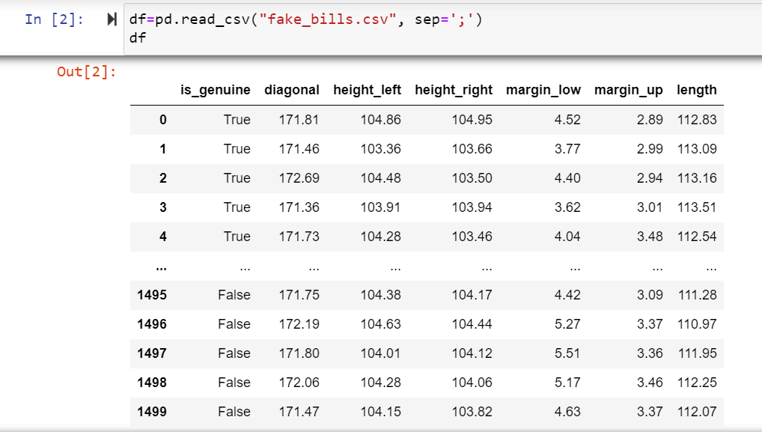
Project Flow:-
Data

Slide 4
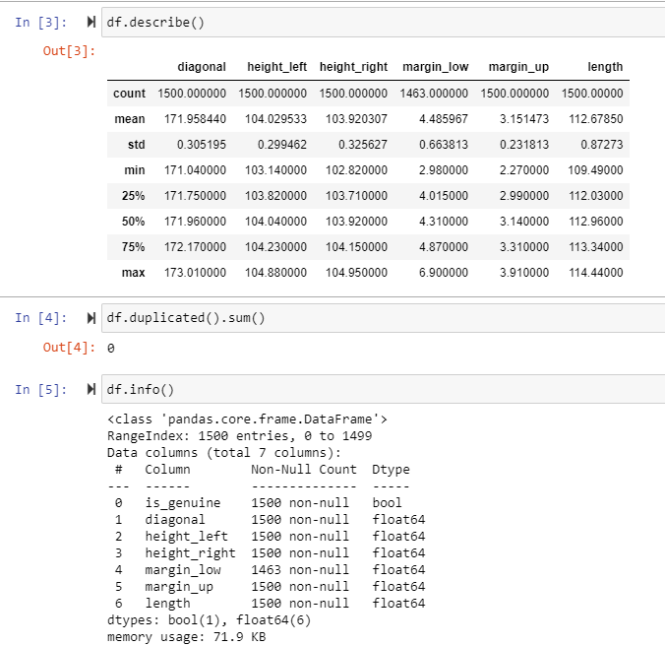
EDA Now let’s start exploring the dataset.
From the describe function we got to know about the count having missing values (So we will have to fill the missing value for making our data read for model building.), the mean, medium, standard deviation of our dataset. The data is normally distributed as mean and medium range is close to each other. And there are no outliers present in our data set.

Slide 5
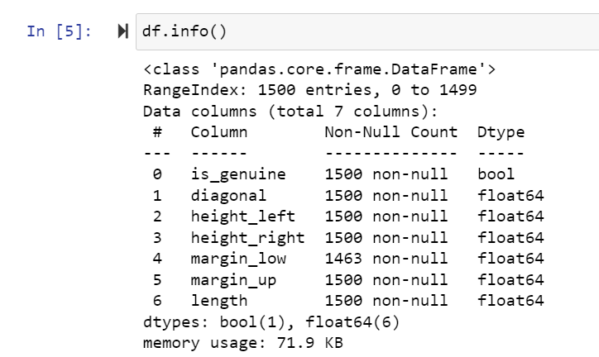
From info function we got to know about data types of all columns.

Slide 6
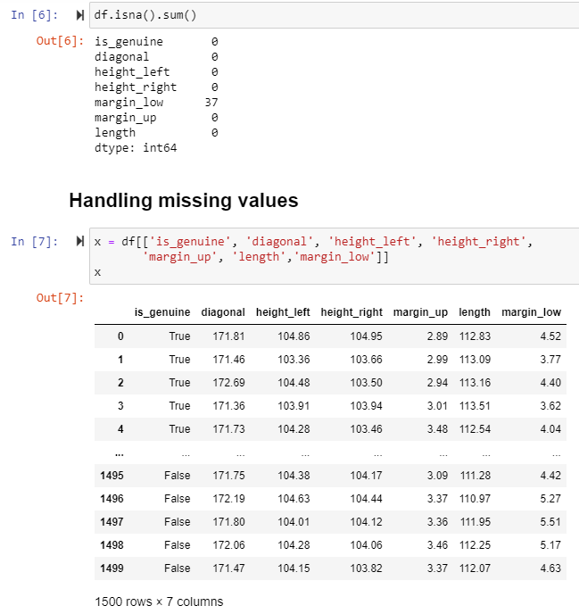
Predicting the missing values with a linear
regression.
So as our data contains missing values, we can remove it by
Mean
Medium
Kmeans Imputer
Linear Regression.
we did it by using linear regression as asked in problem statement.
We have define our data in ‘X’ variable.

Slide 7
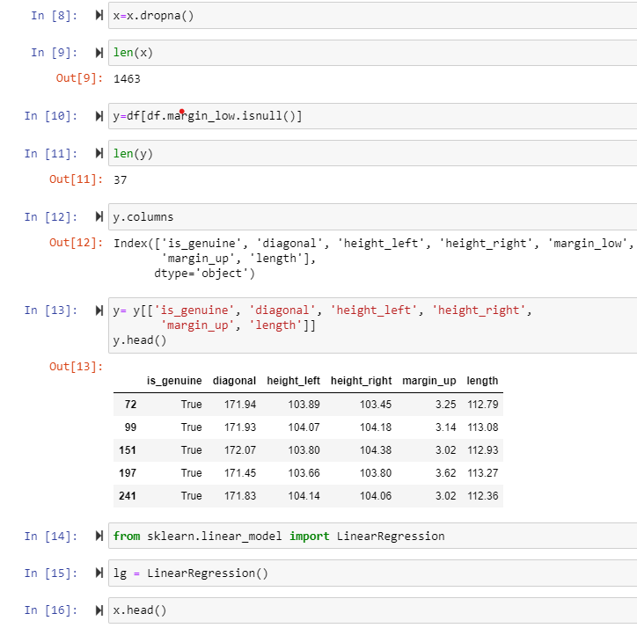
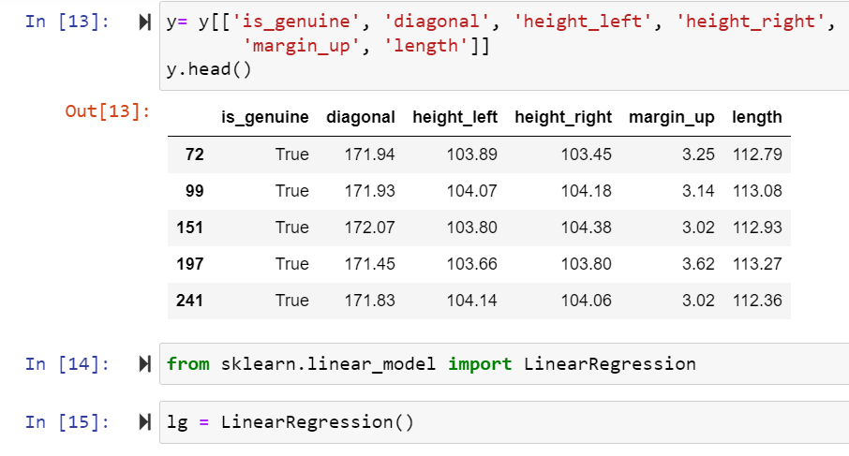
We used dropna function to drop null values from our dataset.
We have defined y as all independent column except margin low and imported linear regression

Slide 8
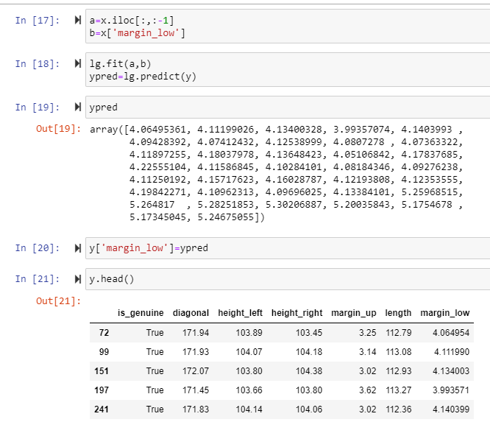
We have split our data into two variables , one have all independent columns except margin low and other having only margin low column. And we have predicted ypred using lg.predict. After predicting missing values, we have added it in y Column.

Slide 9
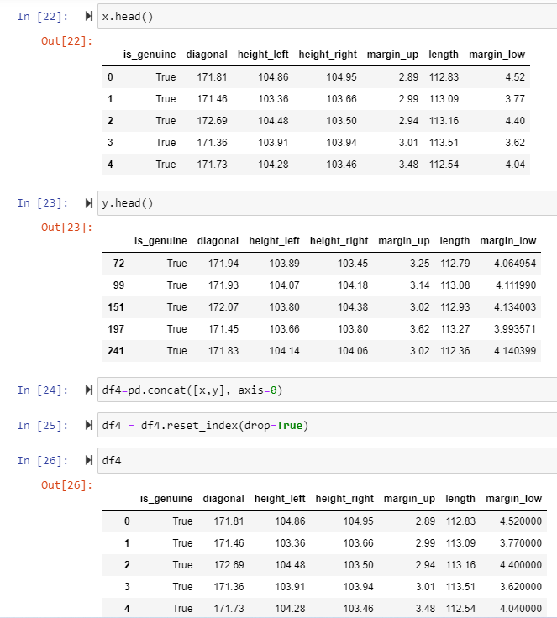
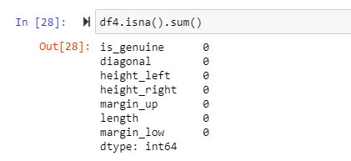
Later we concatenated x and y into one. And our data got free from null values. We have reassigned the index values.

Slide 10
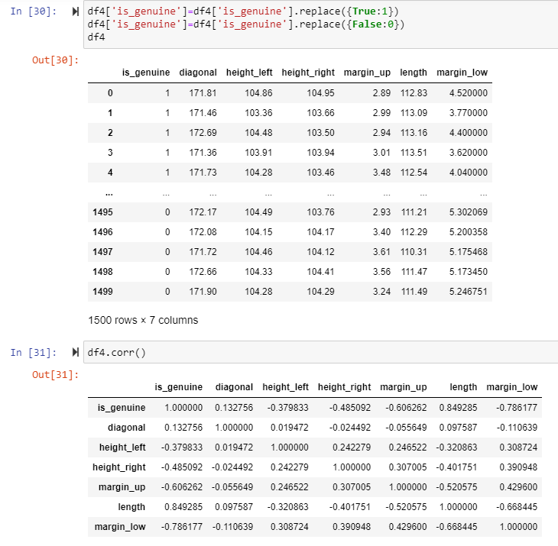
Here we have divided is genuine column values true and false to 1 and 0.

Slide 11
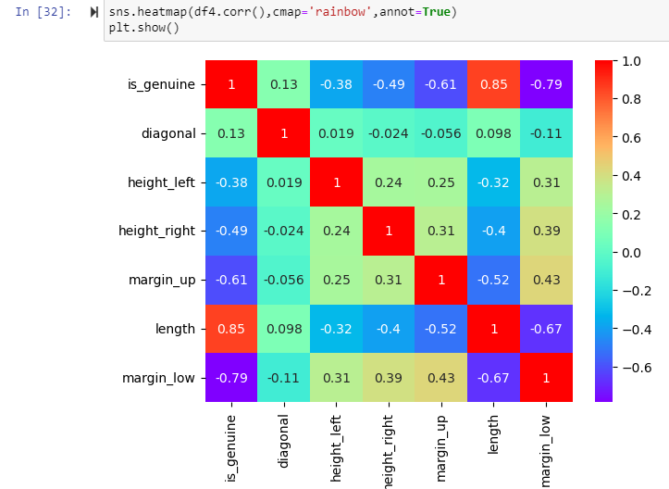
Visualization of our data with Auto Viz
After replacing the missing values, we have made some graphs to have better understanding of data. Firstly to see the correlations between dependent and independent columns, we have plotted Heatmap and from that we are able to understand that the diagonal line is showing 100% relation as it is corelating with itself. And the Ingenuine column and length column have 85% correlation between them. Also Margin up and Ingenuine have -0:61 relation n margin low n Ingenuine have -0.79 . That means there are also have correlation but they are inversely proportionated.

Slide 12
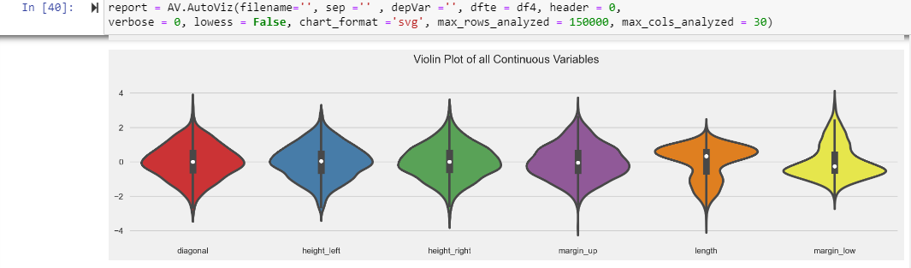
Violin graph is like box plot, but better, violin plot is showing the whole range of data set and the distribution of data. All the information that a box plot would have plus its shape displaying frequencies of values.

Slide 13
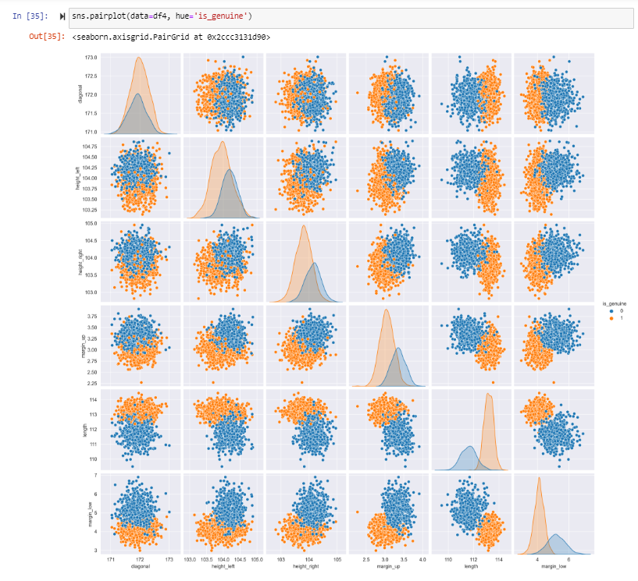
Then We have plotted Pair plot and it show that there is so specific trend in data set.

Slide 14
Model Building
We have did the model building part by building each model separately and via pipeline also.
MODEL’S | ACCURACY | PRECISON | RECALL | SUPPORT
1 Bagging | 0.98 | 0:- 0.99 1:- 0.98 | 0:- 0.96 1:- 1.00 | 0:- 96 1:- 204
2 Boosting | 0.98 | 0:- 1.00 1:- 0.98 | 0:- 0.95 1:- 1.00 | 0:- 96 1:- 204
3 Stacking | 0.97 | 0:- 0.97 1:- 0.98 | 0:- 0.95 1:- 0.99 | 0:- 96 1:- 204
4 Random Forest | 0.99 | 0:- 1.00 1:- 0.99 | 0:- 0.97 1:- 1.00 | 0:- 100 1:- 200
5 SVM | 1.00 | 0:- 0.99 1:- 1.00 | 0:- 0.99 1:- 1.00 | 0:- 150 1:- 300
6 KNN | 0.99 | 0:- 0.99 1:- 0.99 | 0:- 0.98 1:- 1.00 | 0:- 125 1:- 250
7 ANN | 0.99 | 0:- 1.00 1:- 0.98 | 0:- 0.96 1:- 1.00 | 0:- 96 1:- 204
8 Logistic Regression | 0.99 | 0:- 0.98 1:- 1.00 | 0:- 0.99 1:- 0.99 | 0:- 125 1:- 250
9 Naïve Bayes | 0.97 | 0:- 0.98 1:- 1.00 | 0:- 0.96 1:- 1.00 | 0:- 96 1:- 204
10 Decision Tree | 0.99 | 0:- 0.98 1:- 1.00 | 0:- 0.99 1:- 0.99 | 0:- 125 1:- 250

Slide 15
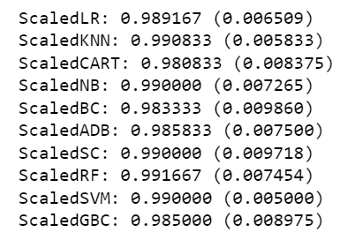
Pipeline Result:-
The accuracy of all models are almost near to 1. We have selected Random Forest as our Final Model.

Slide 16
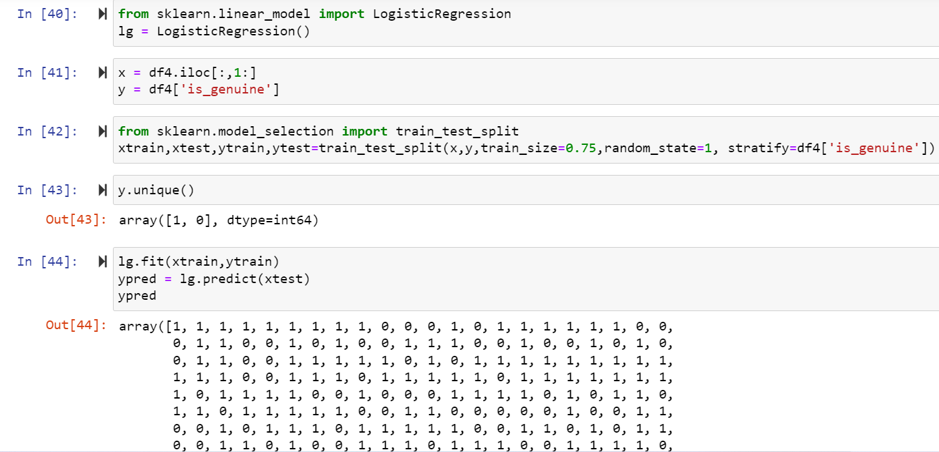
Compare logistic with K-Means
We have imported logistic and Kmeans and split our data into xtrain and ytrain and. Then we predicted Ypred and did standard scaler, and made data frame. Then clusters were formed.

Slide 17
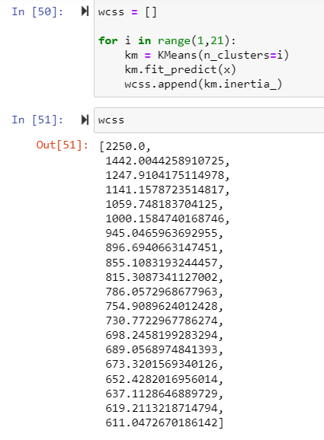
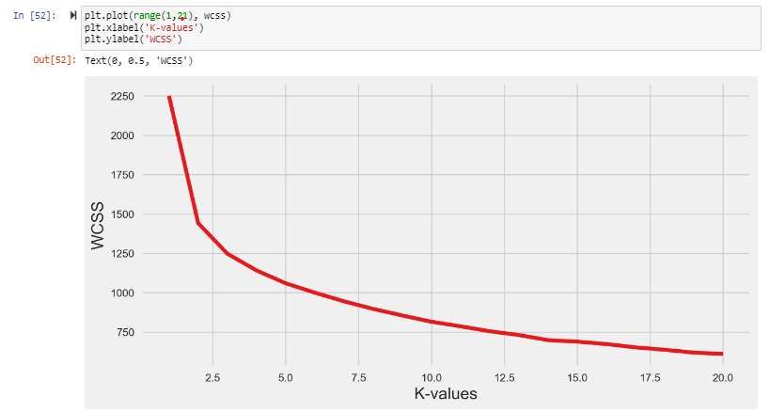
After doing the comparison, we have come to the conclusion that our data is authentic as our model is predicting 2 clusters one for fake and other for genuine bill, and is also showing 98% accuracy.

Slide 18
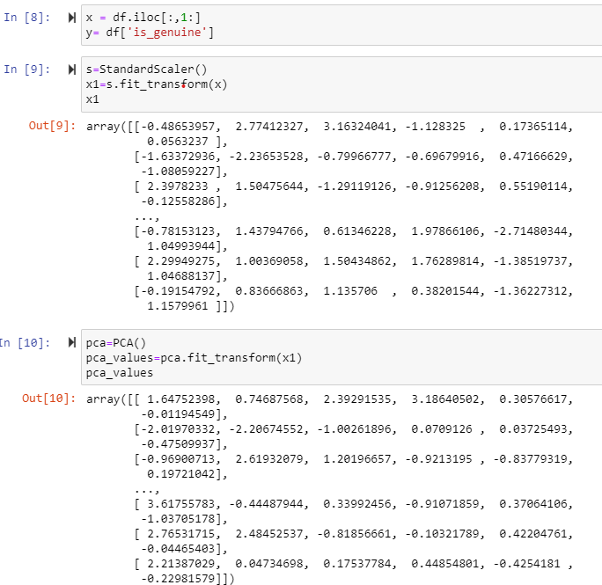
PCA to get a clearer separation between the Genuine and Fake Bills.
For PCA Part, we performed standard scaler, and fitted our data into PCA model

Slide 19
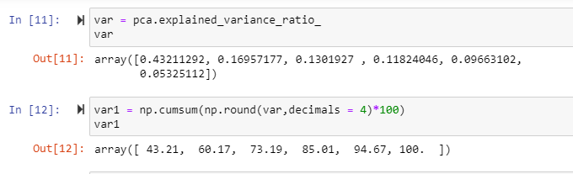
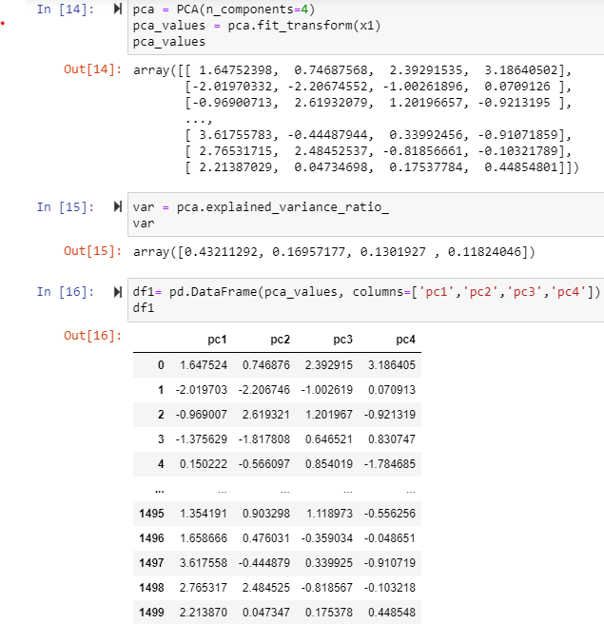
Then we calculated Variance Ratio, and from first 4 output, we are getting highest variance value.
We took first 4 components from variance ratio and fitted it in our PCA model and calculated PCA values.

Slide 20
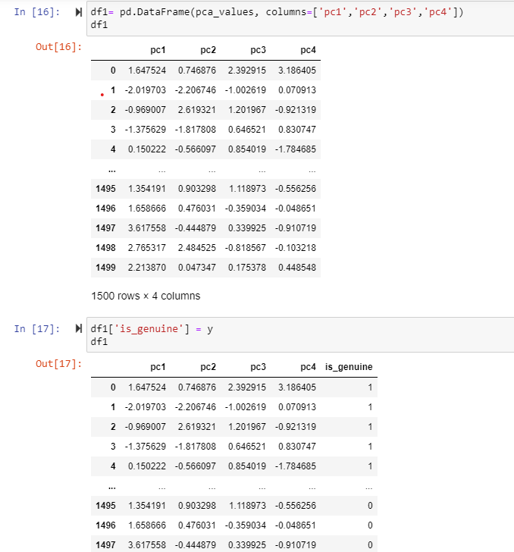
We created data frame with 4 PCA components and added our target column at last in our dataset

Slide 21
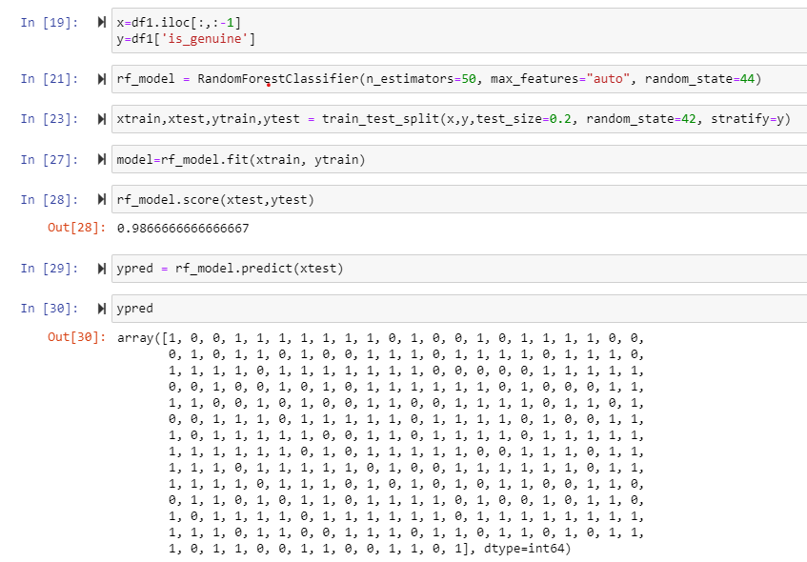
We performed xtrain ytrain on our Random Forest Classifier and got 98% accuracy.

Slide 22
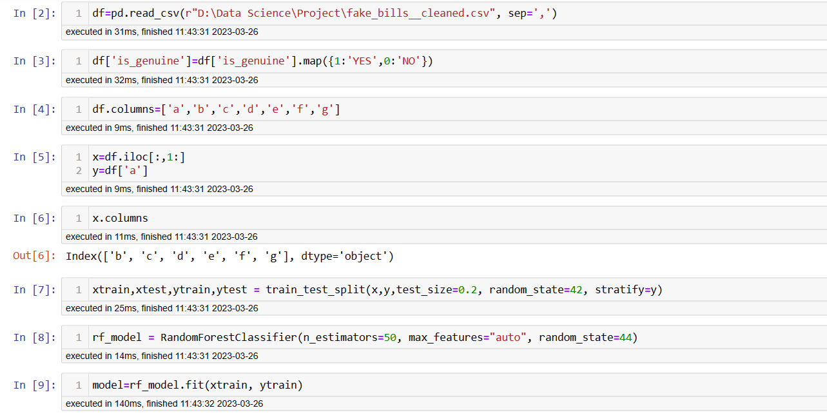
Model Deployment using Stream lit method
We used Stream lit for deployment of our Project Fake bills detection.
First we developed model in Python using Random forest algorithm.
Then using pickle library we exported model in required format.
We developed front end in Spyder using python language.
Below are the screenshots of 1. Random forest model
2. Front end coding
3. Front end.

Slide 23
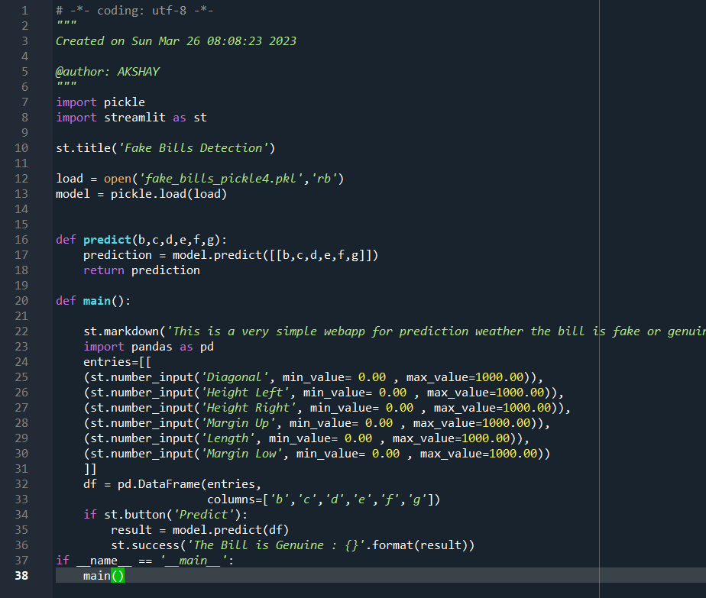

Slide 24
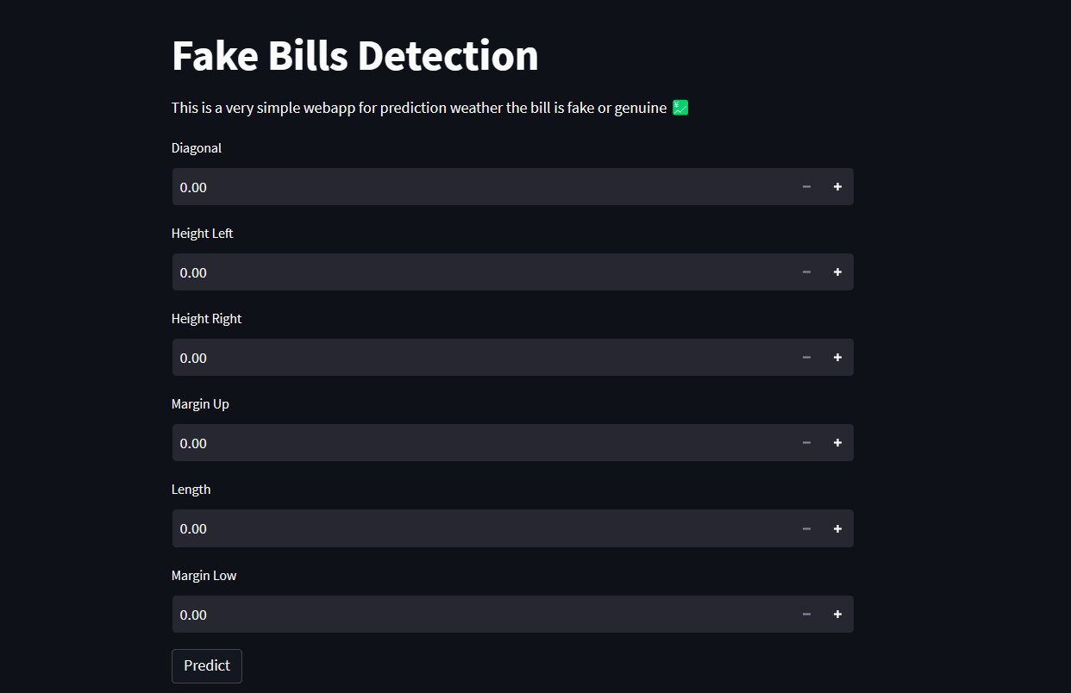

Slide 25
Obstacles encountered and how we found solution for it.
Finding Missing Values using Linear Regression was a new approach for all of us, but with team suggestions and better understanding on how the concept of linear regression will work then we made missing values column as target, and went on with that process. Hence, we got the output what we needed i.e. Our data was free from missing values.
Second challenge we face was after manipulating the data, i.e. after replacing missing value and concatenating datasets, the columns got placed at the bottom of our dataset. So we used reset indexing function to overcome this issue.

Slide 26
Thank you

